Slide 1
Deep Learning
Lec # 02
Class Code : b7fjjwg

Slide 2
Contents
W h a t is R e g r e s sio n – Linefitting ?
G r a die n t D e s c e n t
T h e B a c k P r o p a g a tio n Alg o rit h m
S t o c h a s tic a n d Minib a t c h G r a die n t D e s c e n t
T h e N e u r o n – Biologically
P e r c e p t r o n Lin e a r P e r c e p t r o n a s N e u r o n
G r a die n t D e s c e n t - In tuitio n T h e D elt a R ule s a n d Learning R ule s
H a n d o u t: M S E wit h Sig m oid, c r o s s e n t r o p y + sig, MSE+Softm a x, c r o s s e n t r o p y + s o ft m a x
G r a die n t D e s c e n t wit h Sig m oid N e u r o n s
M ulti-la y e r P e r c e p t r o n

Slide 3
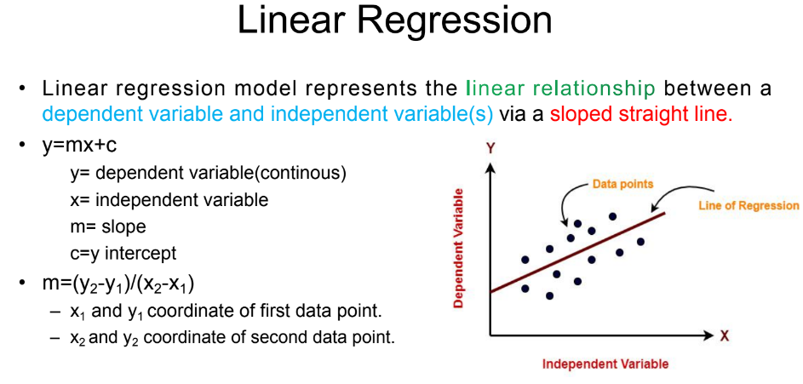

Slide 4
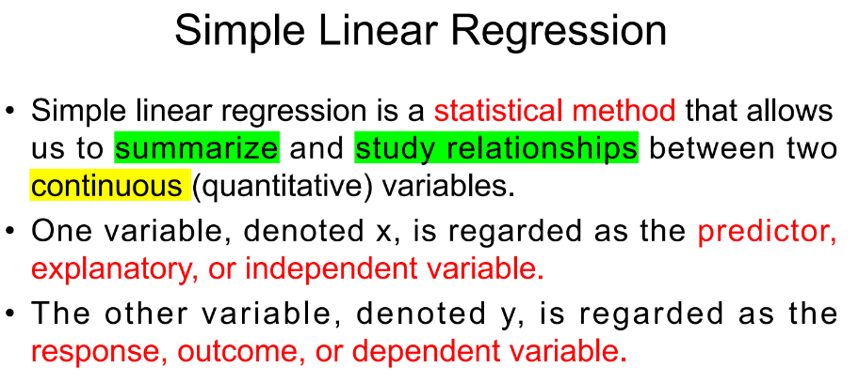

Slide 5
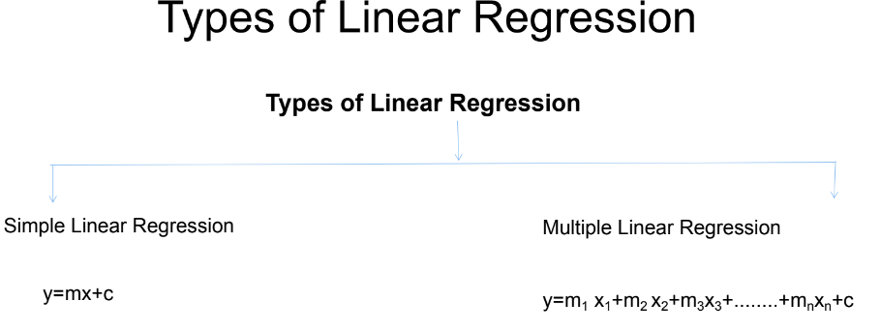

Slide 6
y=mx+c
m (slope): that measures the gradient (direction of its steepness) of the line
c (y-intercept): constant term
(is the value at which the regression line crosses the y-axis)
+ gradient
-ve gradient

Slide 7
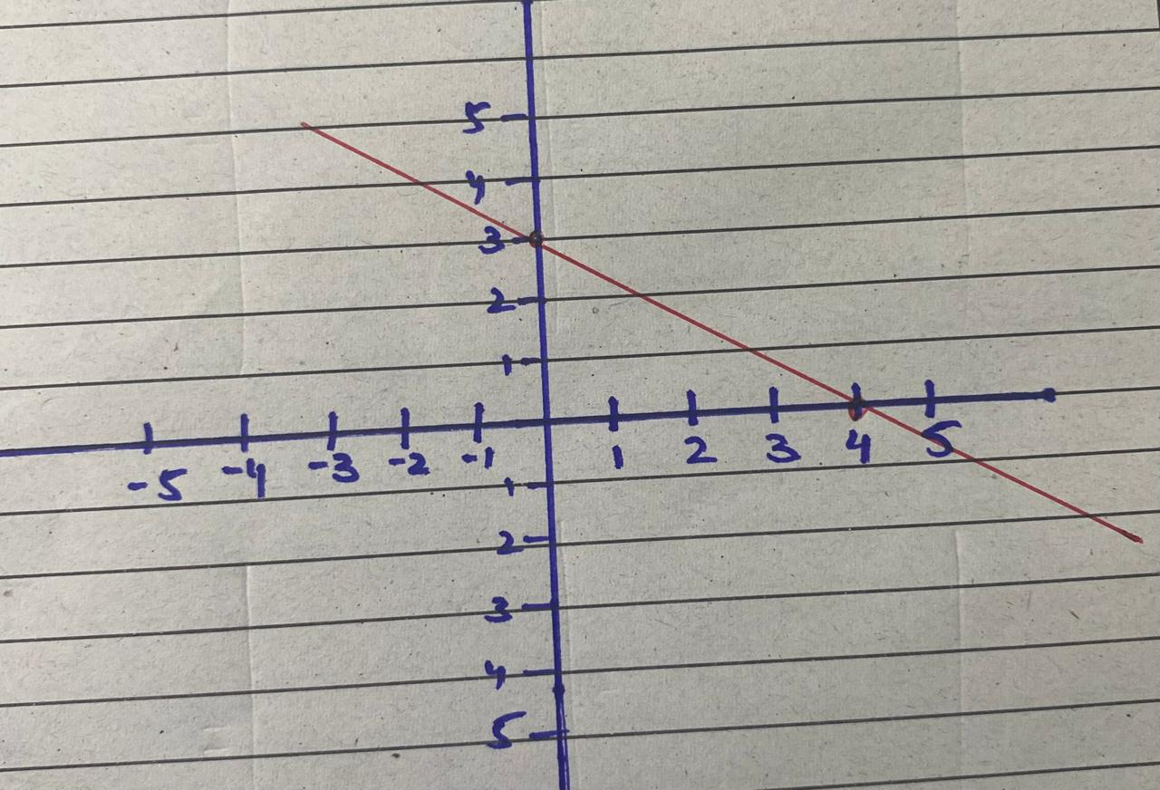
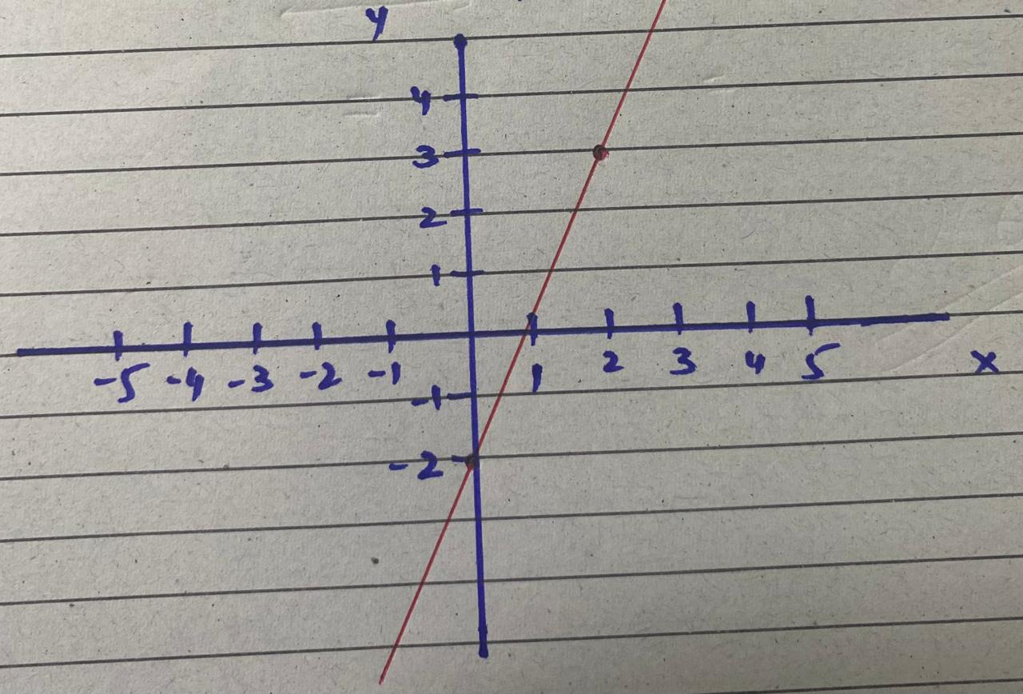
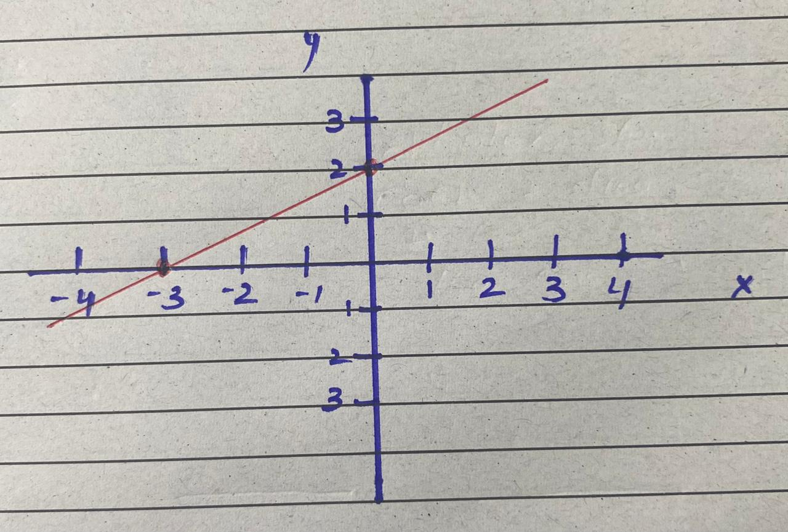
What is the slope and y-intercept of a line?

Slide 8
What is the slope and y-intercept of a line?
c = 3
m = 5/2
y = 5/2 x+3
c = 2
m = 2/3
y = 2/3 x+2
c = 3
m = -3/4
y = -3/4 x+3

Slide 9
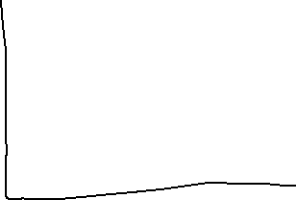
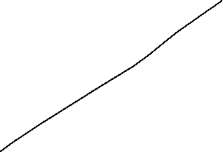
Actual equation of a line
ax + by +c = 0
If c = 0 (the line is passed through the origin)
ax + by = 0

